Slide 1
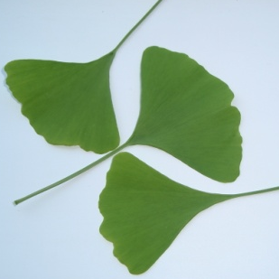
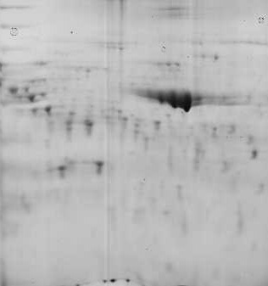
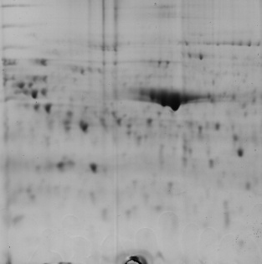
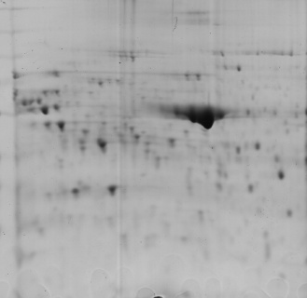
Nitra City Park
7cm, pI 5-8
Phenol extraction
Nitra City Park
PDQuest
190 quantified spots
UPLC MS^{E}
ProteinLynx Global Server
Ginko biloba
spermatophyta
viridiplantae
158 identified proteins
Uvackova et al
Figure 1

